Slide 1
Bryan Tamsir, Hariz Hashim, Olivia Natasha, Kevin Chang, Borui Zhang

Slide 2
Background
We are given six questions from our boss to assess whether or not to implement BOPS.
Given 4 datasets to compare BOPS and BO-Delivery from August 1, 2010 - July 31, 2013:
Transaction Level Data
Consumer Level Data
Online Daily Data - Sales and Return
Online Daily Data - Product Category Sales and Return

Slide 3
Background
There are three online channel stores:
Store #2
Store #6
Store #5998
Implementation of BOPS
Stores 2 and 6 implemented BOPS on August 1st, 2011
Store 5998 implemented BOPS on September 27th, 2012
The difference is 1 year, 1 month and 27 days.

Slide 4
Purpose of Analysis
In particular, we are interested in:
Impact of BOPS on online sales and returns (Q1 and Q2)
Impact of BOPS on online customer behavior (Q3 and Q4)
Product-level impact of BOPS implementation (Q5 and Q6)
Notes:
We go into detail through the presentation

Slide 5
Standardization of Time
Dataset - Online Daily Sales Return
1 (Stores 2 and 6)
0 (Store 5998)
None | BOPS | BOPS
None | None | BOPS
August 1, 2010
July 31, 2013
0
No BOPS
Day 366
1 BOPS
Day 786
Notes:
1 for 366-786
1 for store 2 and 6

Slide 6
Question 1 -What is the impact of implementing BOPs strategy on online sales?
Question 2 -What is the impact of implementing BOPs strategy on online return?
Dataset - Online Daily Sales Return
Model: OLS
log(Y_{Sales Value)=} β₀ + β₁ Time_dummy*Storegroup + β₂ Avg_female+ β₃ Avg_age+ β₄ Avg_income+ β₅ Avg_homeowner+ β₆ Avg_residency+ β₇ Avg_childowner
Model: Negative Binomial
log(Y_{Sales Quantity)=} β₀ + β₁ Time_dummy*Storegroup + β₂ Avg_female+ β₃ Avg_age+ β₄ Avg_income+ β₅ Avg_homeowner+ β₆ Avg_residency+ β₇ Avg_childowner
Model: OLS
log(Y_{Return Value)=} β₀ + β₁ Time_dummy*Storegroup + β₂ Avg_female+ β₃ Avg_age+ β₄ Avg_income+ β₅ Avg_homeowner+ β₆ Avg_residency+ β₇ Avg_childowner+β₈SalesValue
Model: Negative Binomial
log(Y_{Return Quantity)=} β₀ + β₁ Time_dummy*Storegroup + β₂ Avg_female+ β₃ Avg_age+ β₄ Avg_income+ β₅ Avg_homeowner+ β₆ Avg_residency+ β₇ Avg_childowner+β₈SalesQuantity
Notes:
We wanted to also compare the sales quantity as our dependent variable.

Slide 7
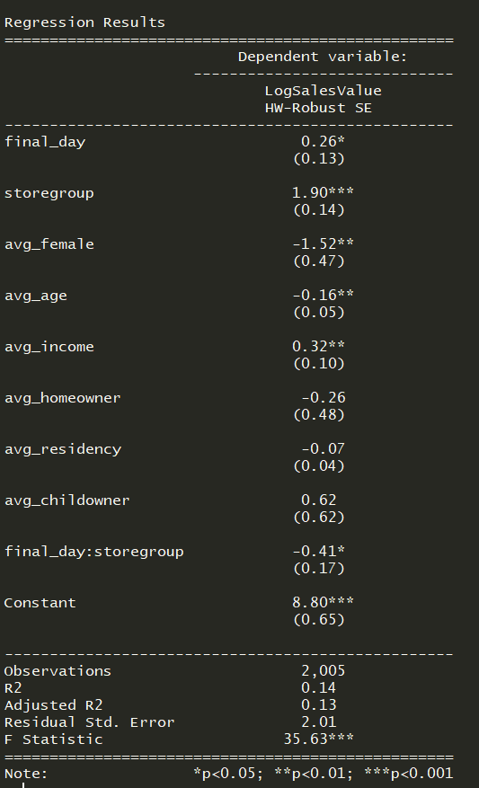
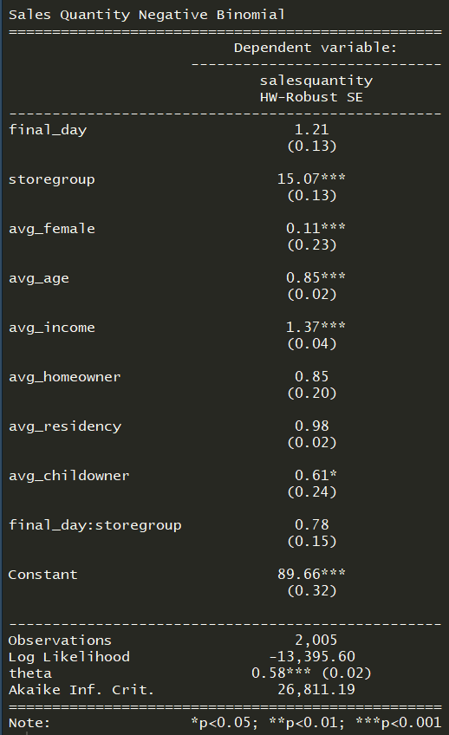
Q1 Sales Value
Q1 Sales Quantity
For stores that have BOPs implemented, there is a decrease in 41% in sales value. | (IRR) Interpretation: For stores that have BOPs implemented, there is a no significant change in sales quantity.
Notes:
Even though the sales quantity are increased, people who use BOPS buy things that are cheaper online when they pick up in store.

Slide 8
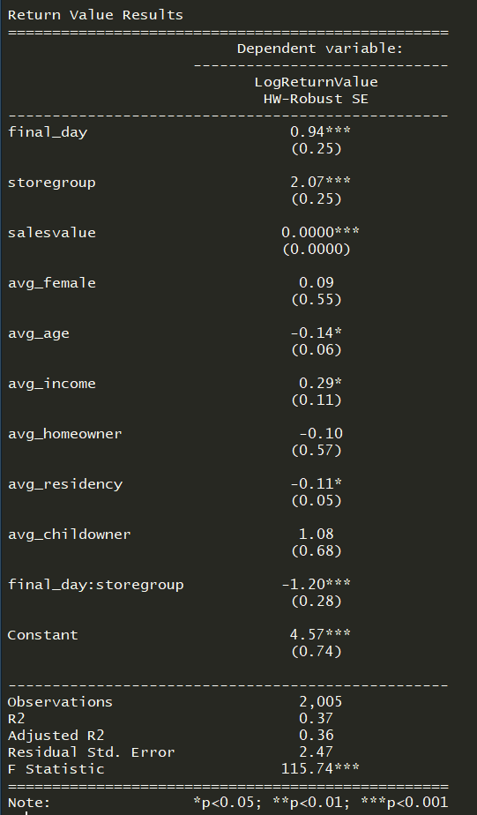
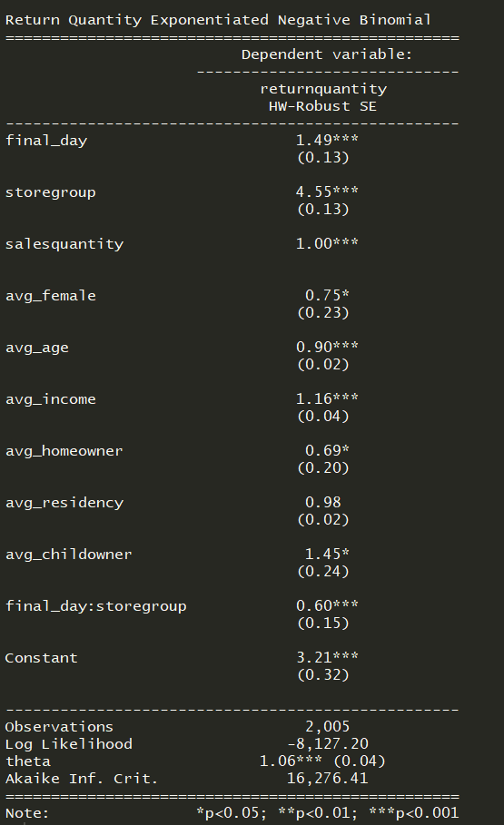
Q2 Return Value
Q2 Return Quantity
For stores that have BOPs implemented, there is a 120% decrease in return value. | (IRR): For stores that have BOPs implemented, there is a 40% decrease in return quantity.
Notes:
Even though the sales quantity are increased, people who use BOPS buy things that are cheaper online when they pick up in store.

Slide 9
Question 3 - What is the impact of using the BOPS service on online customer purchase behavior?
Dataset - Consumer Level Data
Model: Negative Binomial, Dependent Variable: Sales Quantity
Y_{Sales Quantity =} β₀ + β₁Bops_in_effect*Bops_user + β₂ Avg_female+ β₃ Avg_age+ β₄ Avg_income+ β₅ Avg_homeowner+ β₆ Avg_residency+ β₇ Avg_childowner
Model: OLS, Dependent Variable: Log(Sales Value + 1)
log(Y_{Sales Value) =} β₀ + β₁Bops_in_effect*Bops_user + β₂ Avg_female+ β₃ Avg_age+ β₄ Avg_income+ β₅ Avg_homeowner+ β₆ Avg_residency+ β₇ Avg_childowner
Notes:
We chose this dataset because it gives us a more detailed information about each individual customers
With sales quantity we use negative binomial because sales quantity are discrete and positive value and with sales value we choose to use OLS
Notice how both model has bops_in_effect*bops_user as an interaction term, we use bops_in_effect as a measurement of time and interact it with bops user so we can see the difference in sales quantity and sales value when bops is present and customers who actually uses it

Slide 10
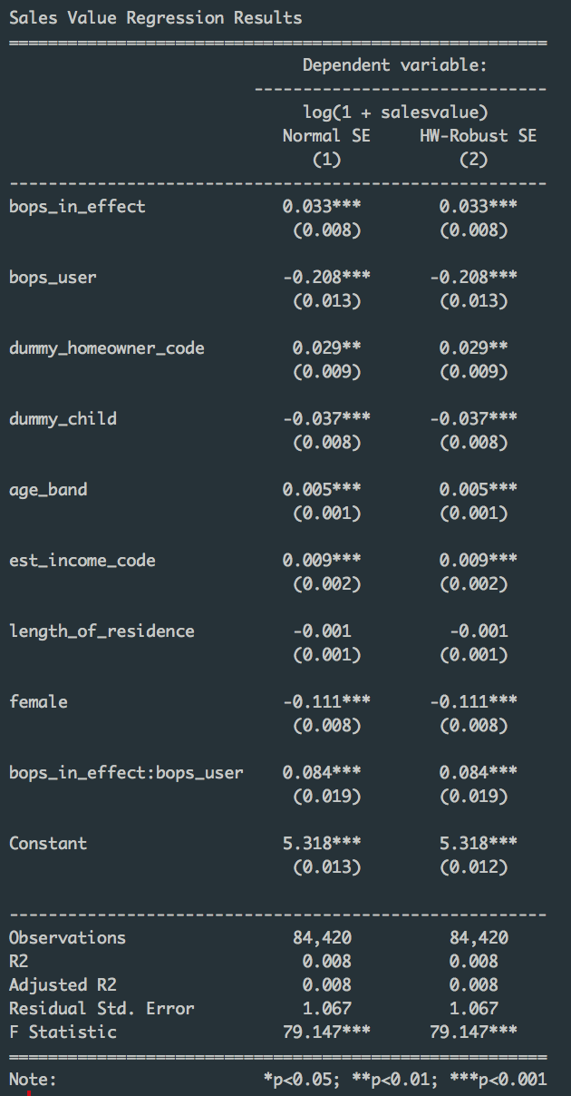
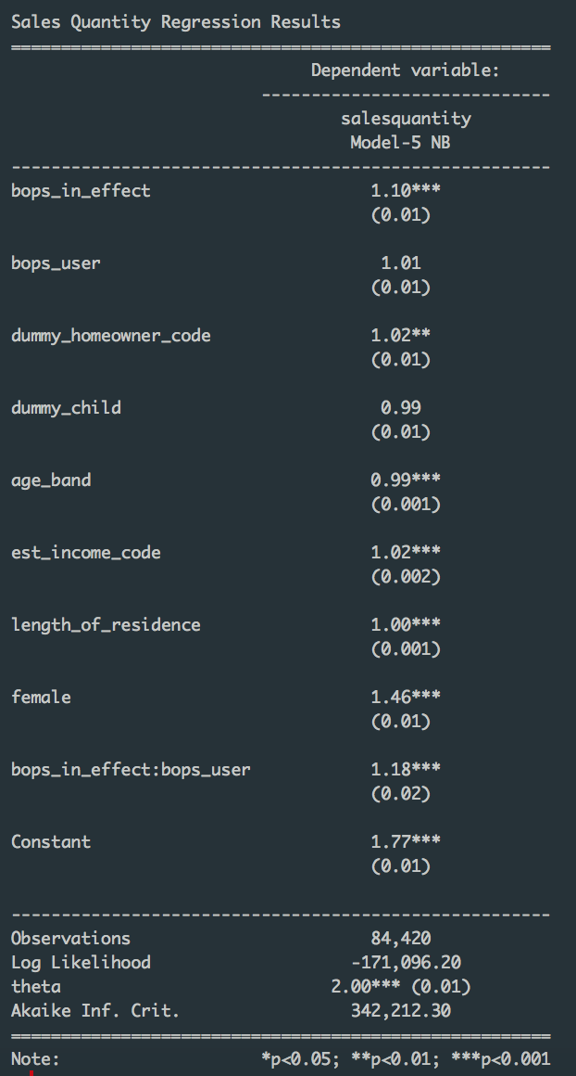
Q3 Sales Value
Q3 Sales Quantity
Interpretation: For a one unit increase in bops user when bops is in effect, expected sales value increases by 8.4% | (IRR): For a one unit increase in bops user when bops is in effect, the expected count increases by 18%
Notes:
We compared between poisson and negative binomial and see that negative binomial is a better fit for this specific model
Since there is no heteroskedasticity present, this is our result, for our sales quantity
For Sales Value, we see that heteroskedasticity is present, therefore we have the robust standard error

Slide 11
Question 4 - What is the impact of using the BOPS service on online customer return behavior?
Conceptual model:
We expect customers using BOPS to have an increased likelihood of returning their purchase.
To assess this hypothesis, we use transaction level data to analyze, since it holds information on customers, purchase delivery method (BOPS vs home delivery), and purchase return information and also address endogeniety.
Y_{Return} = β₀ + β₁BOPS + β₂log(Price) + β₃Store Number + β₄Age Band + β₅Month + β₆Year + β₆Product Category + β₆Age Band + β₇Female + β₈Has Child
Link to summary statistics

Slide 12
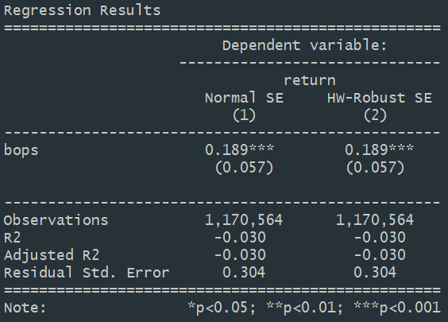
Estimation results
Y_{Return} = β₀ + β₁BOPS + ∑ β_{i}Controls
X₁ = 𝛾₀ + 𝛾₁Length of Residence + ∑ 𝛾_{j}Controls
Note: 2SLS model used in estimation
A transaction using BOPS service is associated with an increase of 18 percentage points in likelihood of product returns
Note: Control variables omitted for brevity
Link to full model output

Slide 13
Question 5 -What is the impact of implementing BOPS strategy on product-level sales and return?
Dataset - Online Daily Product Category Sales/Return
Model: OLS
log(Y_{Sales Value)=} β₀ + β₁ Time_dummy*Storegroup + β₂ Avg_female+ β₃ Avg_age+ β₄ Avg_income+ β₅ Avg_homeowner+ β₆ Avg_residency+ β₇ Avg_childowner+ β₈ Product Category
Model: Negative Binomial
log(Y_{Sales Quantity)=} β₀ + β₁ Time_dummy*Storegroup + β₂ Avg_female+ β₃ Avg_age+ β₄ Avg_income+ β₅ Avg_homeowner+ β₆ Avg_residency+ β₇ Avg_childowner+ β₈ Product Category
Model: OLS
log(Y_{Return Value)=} β₀ + β₁ Time_dummy*Storegroup + β₂ Avg_female+ β₃ Avg_age+ β₄ Avg_income+ β₅ Avg_homeowner+ β₆ Avg_residency+ β₇ Avg_childowner+ β₈ Product Category+ β₉ SalesValue
Model: Negative Binomial
log(Y_{Return Quantity)=} β₀ + β₁ Time_dummy*Storegroup + β₂ Avg_female+ β₃ Avg_age+ β₄ Avg_income+ β₅ Avg_homeowner+ β₆ Avg_residency+ β₇ Avg_childowner+β₈ Product Category+ β₉ SalesQuantity
Notes:
We wanted to also compare the sales quantity as our dependent variable.

Slide 14
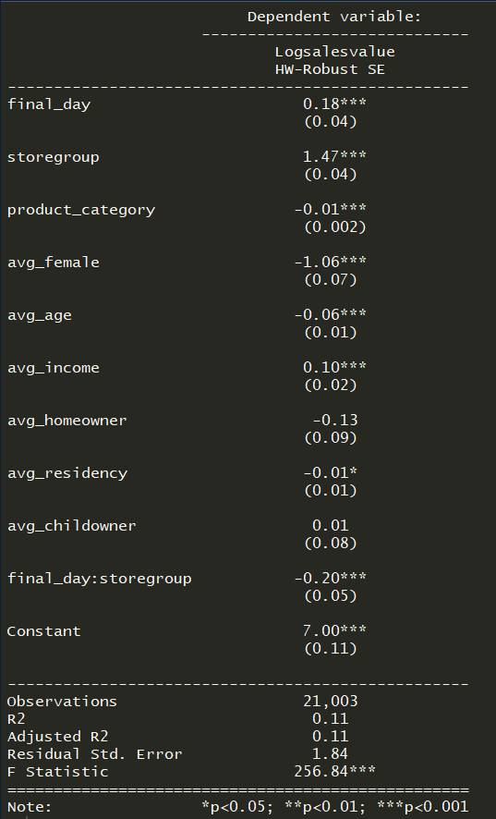
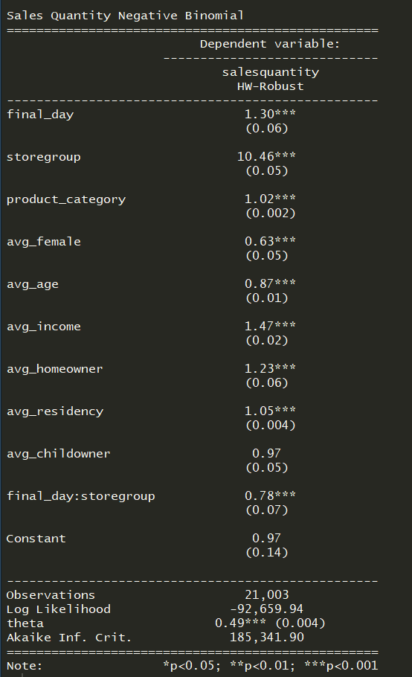
Q5 Sales Value
Q5 Sales Quantity
For stores that have implemented BOPS, there is a 20% decrease in sales value. | (IRR)Interpretation: For stores that have implemented BOPS, there is a 22% decrease in sales quantity.
Notes:
Even though the sales quantity are increased, people who use BOPS buy things that are cheaper online when they pick up in store.

Slide 15
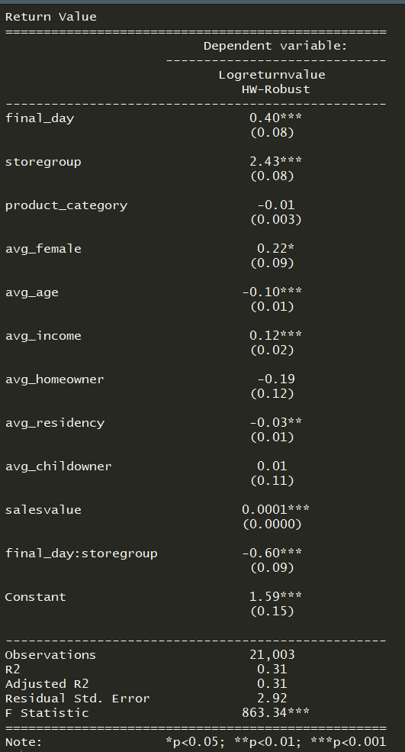
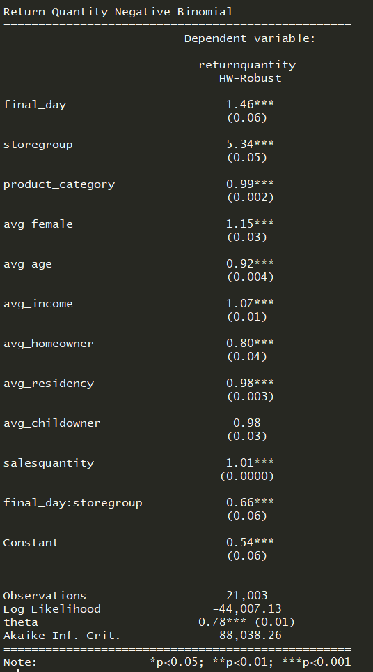
Q5 Return Value
Q5 Return Quantity
Interpretation: For stores that have implemented BOPS, there is a 60% decrease in return value. | (IRR): For stores that have implemented BOPS, there is a 34% decrease in return quantity.
Notes:
Even though the sales quantity are increased, people who use BOPS buy things that are cheaper online when they pick up in store.

Slide 16
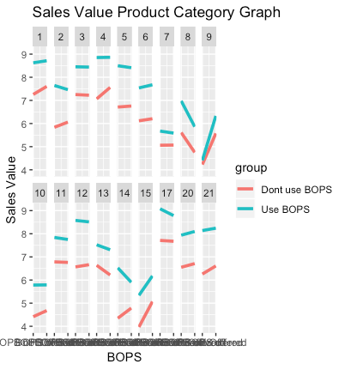
Q6 - Sales Value
The marginal effect plots for all product categories Sales Value
We found that only 2 out of the 21 categories have a significant difference.
Product #4 (Diamond Fashion)
Product #14 (Pre-Owned)

Slide 17
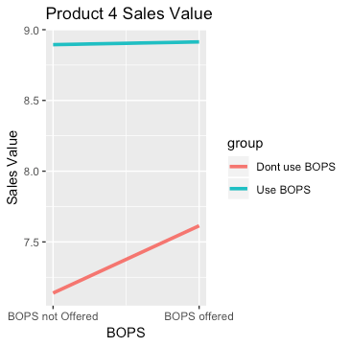
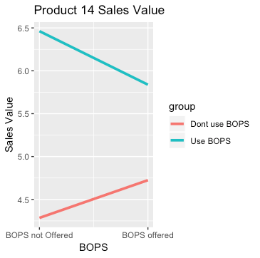


Interpretation: When BOPS is available and in use, it led to a decrease of 46% in sales value for Diamond Fashion products
Interpretation: When BOPS is available and in use, it led to a decrease of 106% in sales value for Pre-Owned products

Slide 18
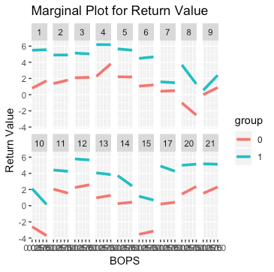
Q6 - Return Value
The Marginal plot for all categories
Return Value
We found that 3 out of the 21 categories have a significant difference
Product #4 (Diamond Fashion)
Product #14 (Pre-Owned)
Product #21 (Sterling Silver)

Slide 19



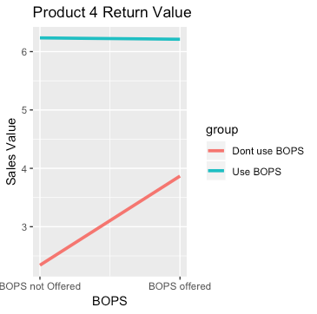
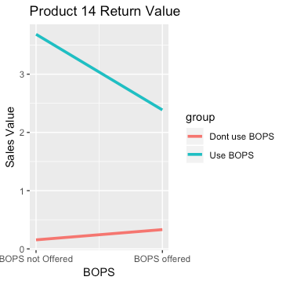
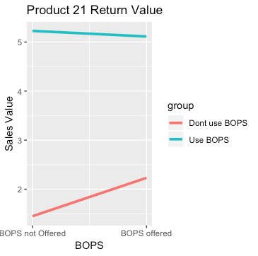
Product Categories with Significant Changes With BOPS:
In these product categories, the use of BOPS led to a decrease of 155%, 148%, and 90% in sales value.
Category 4
Category 14
Category 21

Slide 20
To recap
Question | Model | Outcome | Dataset
Q1 - Impact of BOPs on online channel sales. | OLS | Decrease in sales value by 40%. No change in sales quantity. | Online Daily Data - Sales and Return
Q2 - Impact of BOPs on online channel returns. | Negative Binomial | Decrease in return value by 120% Decrease in return quantity by 40%. | Online Daily Data - Sales and Return
Q3 - Impact of using BOPS service on online customer purchase behavior. | OLS and Neg Bin | Increase in sales value by 8.4% Increase in sales quantity by 18% | Consumer Level Data
Q4 - Impact of using BOPs service on online customer return behavior. | OLS, Probit, and IV/2SLS | Increase in return likelihood by 18 p.p. | Transaction Level Data
Q5 - Impact of implementing BOPS strategy on product level sales and returns. | OLS and Neg Bin | Decrease in sales value by 20% and 22% in sales quantity. Decrease in return value by 60% and 34% decrease in return quantity. | Online Daily Data - Product Category
Q6 - Impact of implementing BOPS strategy vary across product categories. | OLS | The effect of implementing BOPS strategy depends on product category number. | Online Daily Data - Product Category

Slide 21
Managerial Insight
We do not recommend a universal BOPS rollout because the effects differ at different levels of analysis:
Limit BOPS to loyal customers since repeat customers bought more when using BOPS.
Target specific product categories such as product #21, sterling silver
We gather more data on online user transaction
ROPO - Research Online, Purchase Offline
We gather more data on more channels that have implemented BOPS

Slide 22
Limitations
We don’t know how much the implementation of BOPS costs and if it is scalable.
If implementation of BOPS results in insignificant change in net profits, implementation results in a loss.
We indicate that a consumer uses BOPS due to convenience (near the store), however we do not have any data of how far consumers are from the store
Person using BOPS likely lives near store, making it convenient for them to return in store (vs by mail). Dataset lacks distance to store information.
We don’t know if customer returns are converted to in-store credit or exchange.
Without this information, we could be overestimating effect of BOPS on returns.
We were not given full details on the return policy of the stores and online channels
Cost for customers to use BOPS versus being delivered

Slide 23
Appendix

Slide 24
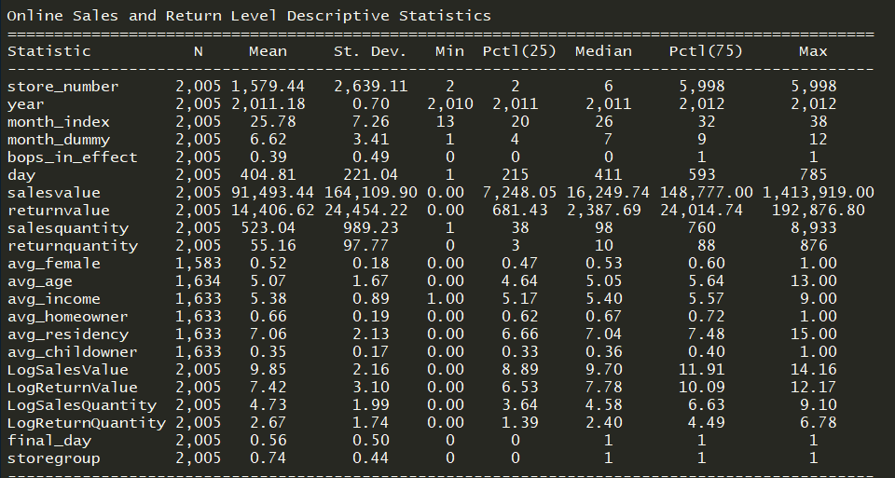
Summary Statistics - Online Daily Returns/Sales before replacing NA with mean
Notes:
Missing Dataset after subsetting and before replacing NAs with mean

Slide 25
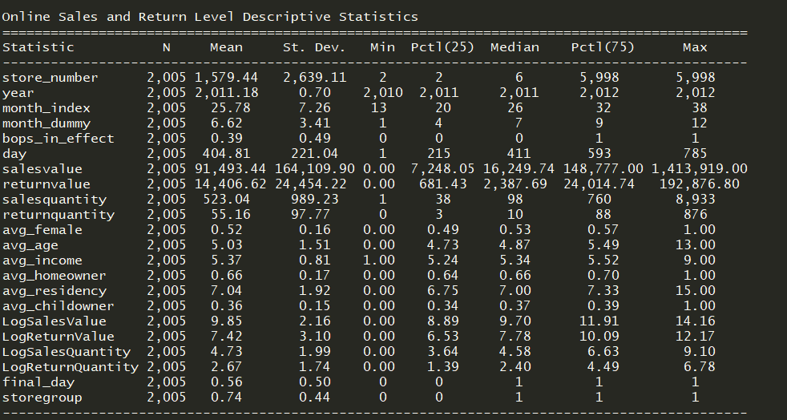
Summary Statistics - Replace NA with Average
Notes:
We had missing data in all the avg variables but we replaced the NAs with average values. This led to a complete data set.

Slide 26
Q1 Analysis of Control Variables
Avg_Female - the ratio of all female customers to all customers
Avg_Age - average age_band of all customers at the given aggregation level and note that this is not the actual age. It is the average of age groups. The higher it is, the older the customer profile is
Avg_Income - the average income_band of all customers at the given aggregation level. It is the average of income groups. The higher it is, the richer the customer profile is
Avg_Homeowner - the ratio of customers who own their house to all customers (homeowners + renters)
Avg_Residency - the average number of years spent in the current address for customers Avg_Childowner - the ratio of customers who have at least one child to all customers
Exclude: Store Number, Year, Product Category, Month, Month_index, Month_dummy, and Bops_In_Effect

Slide 27
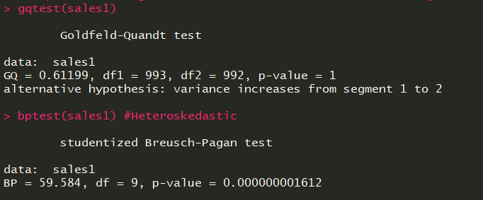
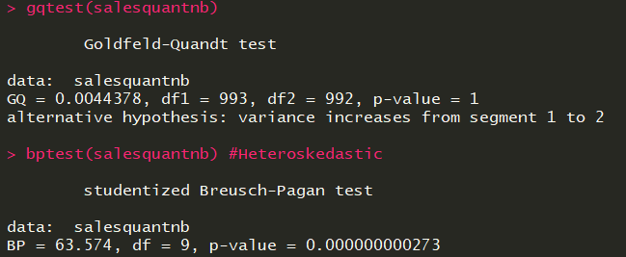
Q1 Sales Value/Quantity - Heteroskedasticity
Sales Value
Sales Quantity
Fixed with HW Robust Standard errors!

Slide 28
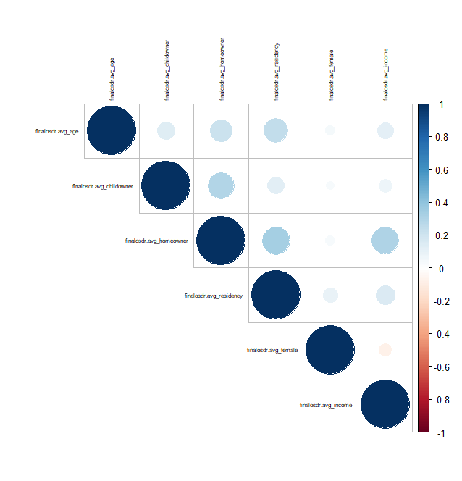
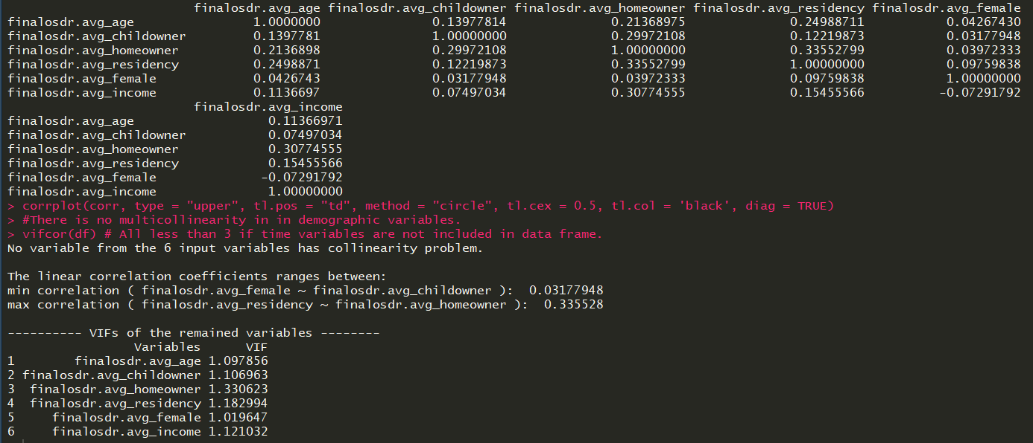
Q1/2 - Online Daily Sales/Returns Multicollinearity

Slide 29
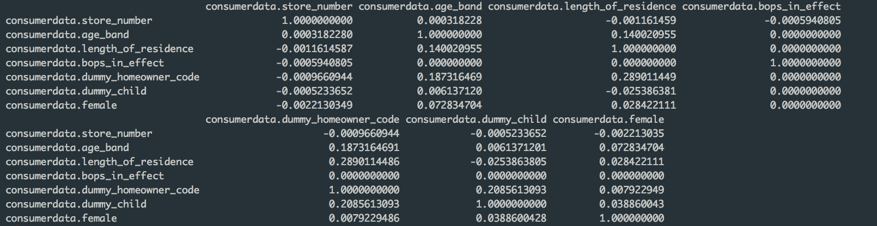
Question 3 - Multicollinearity

Slide 30
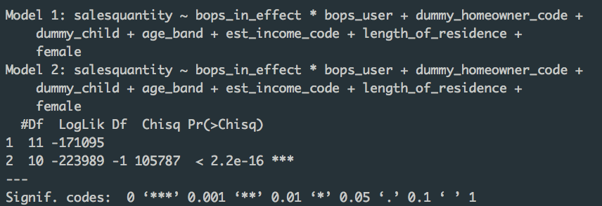
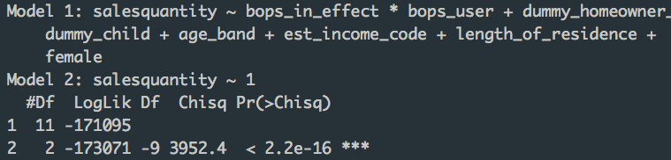
Q3 - Sales Quantity, Choosing a Model

Slide 31
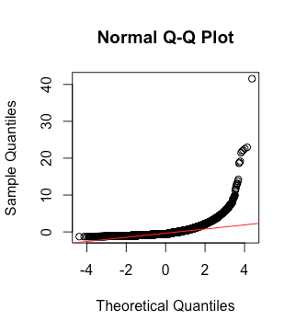
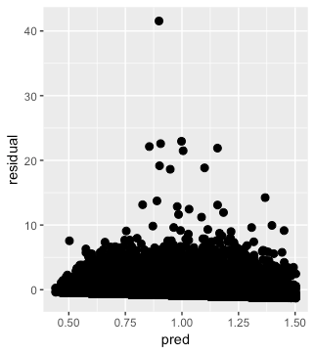
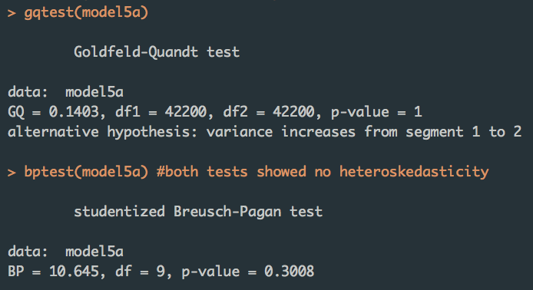
Q3 - Sales Quantity Heteroskedasticity

Slide 32
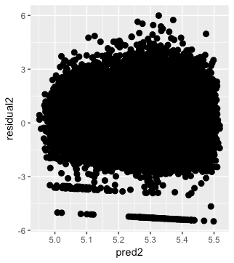
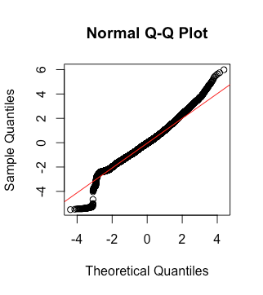
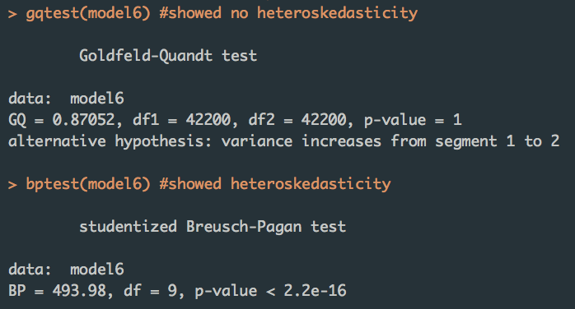
Q3 - Sales Value Heteroskedasticity

Slide 33
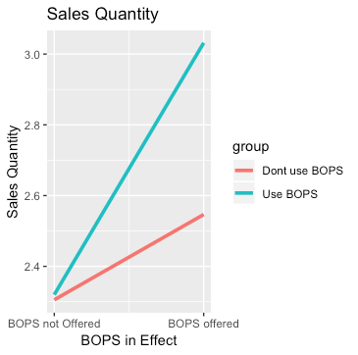
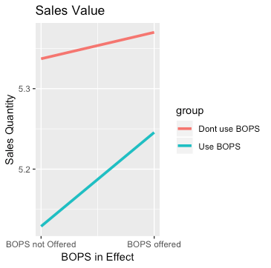
Q3 - Marginal Plot

Slide 34
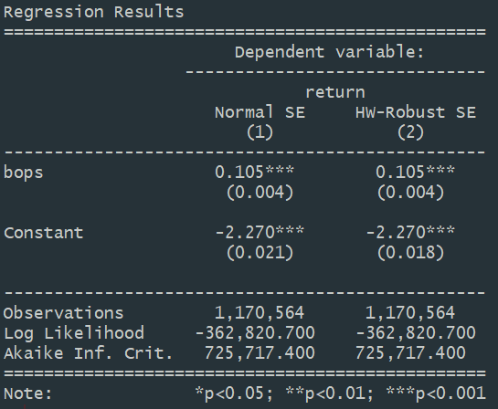
Question 4 - Probit model approach
BOPS coefficient is significant. However, interpreting the coefficient for a probit model is difficult to understand
Note: Control variables omitted for brevity
Link to full model output

Slide 35
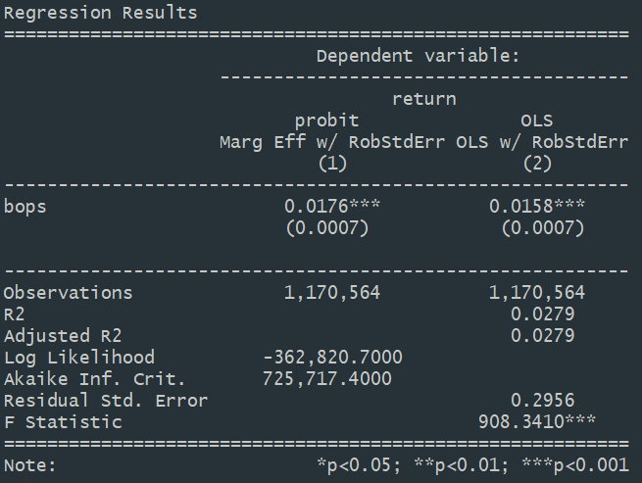
Question 4 - Comparable to OLS model
To compare OLS and probit models, we first have to generate the marginal effects of the probit model (left column).
Since the marginal effects coefficient of BOPS in the probit model is similar to that of the OLS model, we can assume that the OLS model is a good estimator as well.
Note: Control variables omitted for brevity
Link to full model output

Slide 36
Question 4 - Addressing endogeneity
Conceptually, the key ind. var. BOPS is a decision variable that is correlated with our dependent variable. Thus, endogeneity is present in our model:
We address this endogeneity by utilizing length of residence as an instrumental variable for BOPS
Why length of residence as proxy?
We believe the longer a customer has lived at an address, the less likely they are to use BOPS service (due to familiarity of safety within a neighborhood)
Y_{Return} = β₀ + β₁BOPS + ∑ β_{i}Controls
X₁ = 𝛾₀ + 𝛾₁Length of Residence + ∑ 𝛾_{j}Controls
Link to full model output

Slide 37
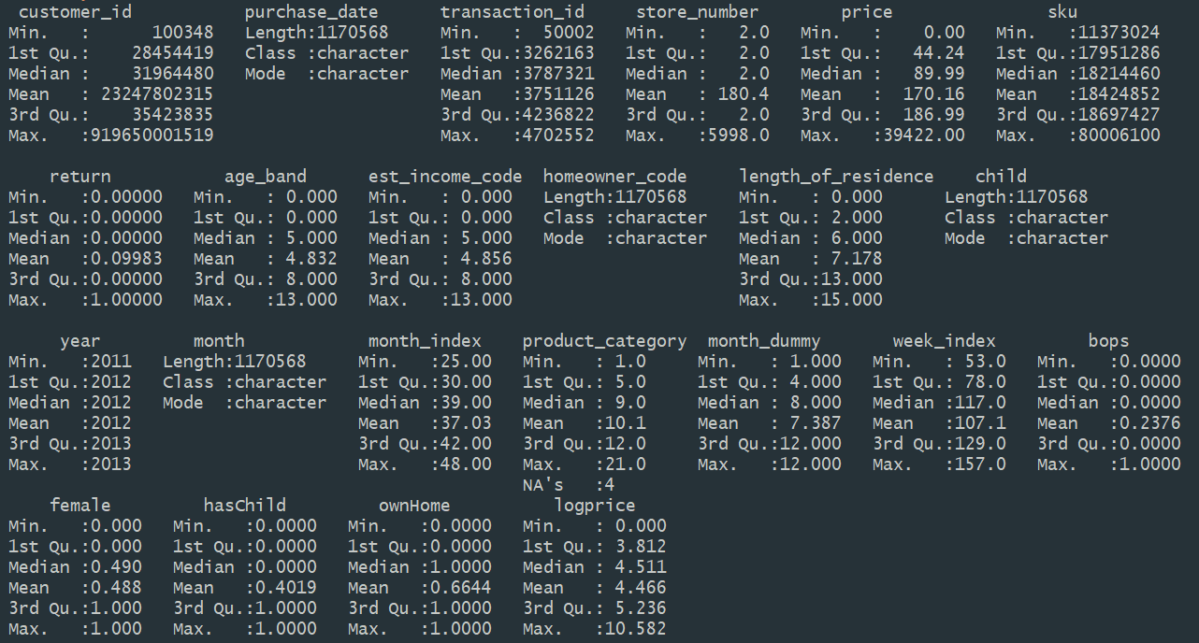
Question 4 - Summary Statistics
Notes on data clean-up:
Data was subset to only include data points when bops was implemented.
Missing data points were replaced with sample mean (e.g. age_band, length_of_residence, female), except for “Product Category” variable.
“hasChild” is dummy variable for “child”.
“ownHome” is dummy variable for “homeowner_code”.
“Logprice” created as “price” variable was right-skewed.

Slide 38
Question 4 - Standardization of Time
Since we are concerned with the effect of BOPS on return, we will exclude all data points when BOPS was not implemented (i.e. BOPS = n/a):
None | BOPS | BOPS
August 1, 2010
July 31, 2013
Day 366
Day 786
Notes:
1 for 366-786
1 for store 2 and 6

Slide 39
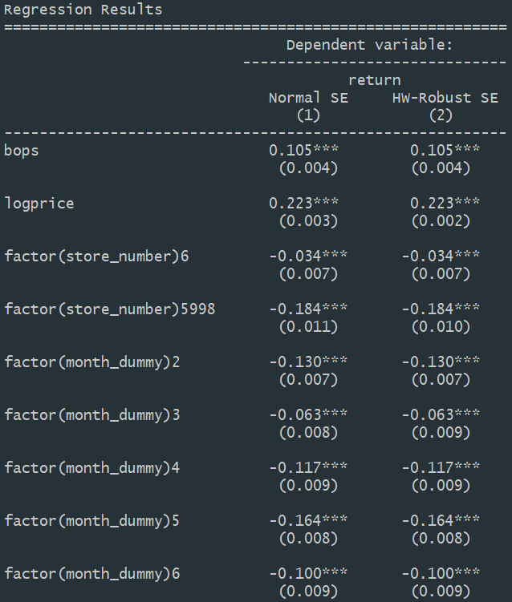
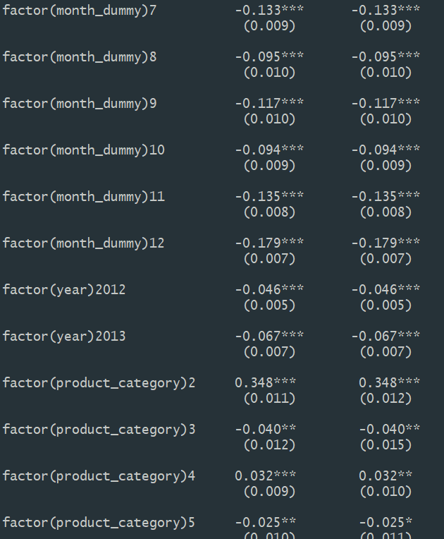
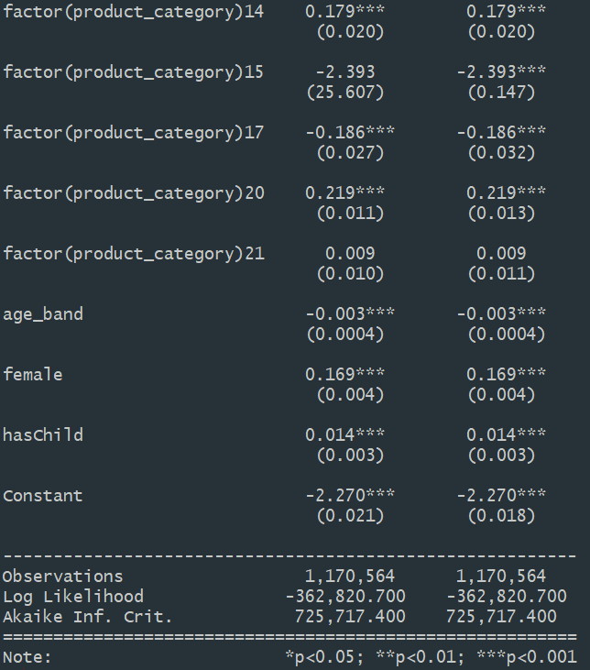
Question 4 - Full Probit Output

Slide 40
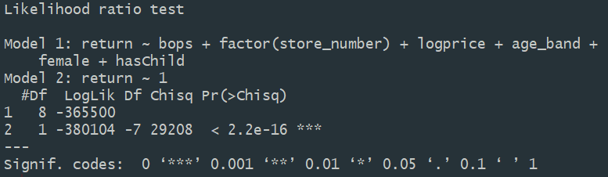
Question 4 - Likelihood Ratio Test & Predictive Power
To test model fit, a new probit model with fewer control variables was created (Model 1) and compared to a null model:
The test is significant, indicating that the model with variables beats the null model.
We can conclude that our initial model (with more variables) fits the data.
This model has a very good predictive power

Slide 41
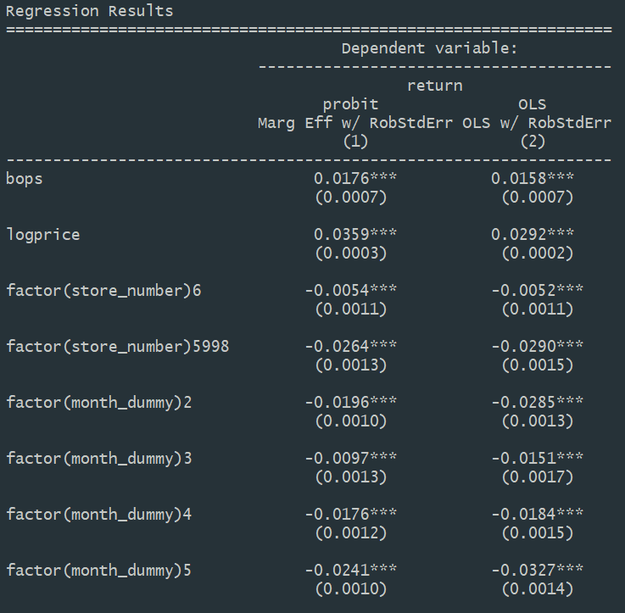
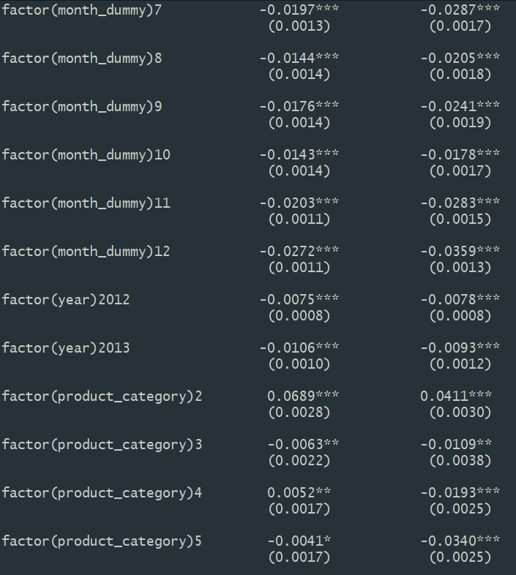
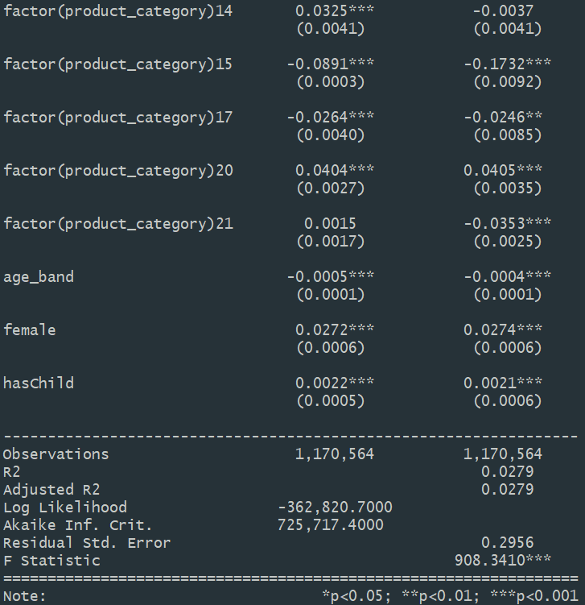
Question 4 - Full OLS v Probit

Slide 42
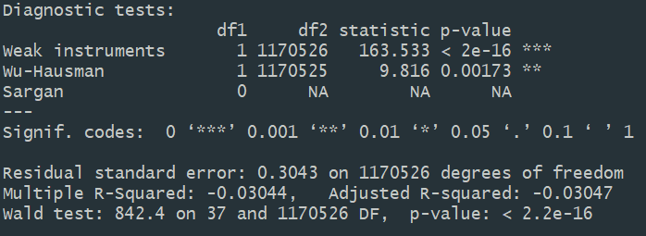
Question 4 - IV Reg Diagnostics
Using length of residence as an instrument variable. Note:
Sargan test unavailable since only one instrument used
F-statistic of 163 > 10 - the instrument in use is relevant
Significant Hausman test, so we will interpret the IVReg/2SLS model estimation

Slide 43
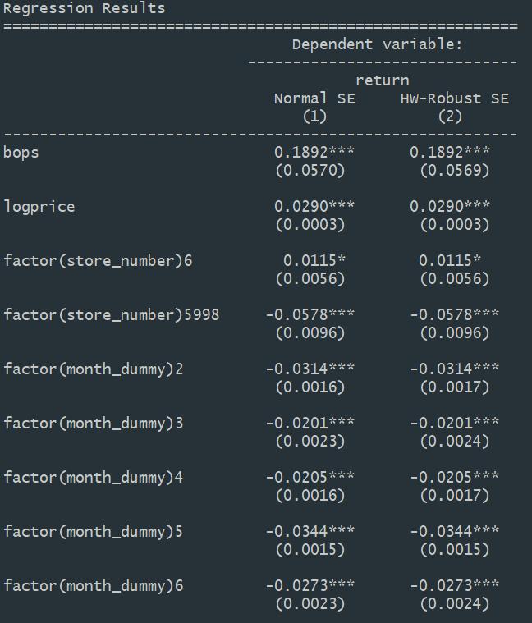
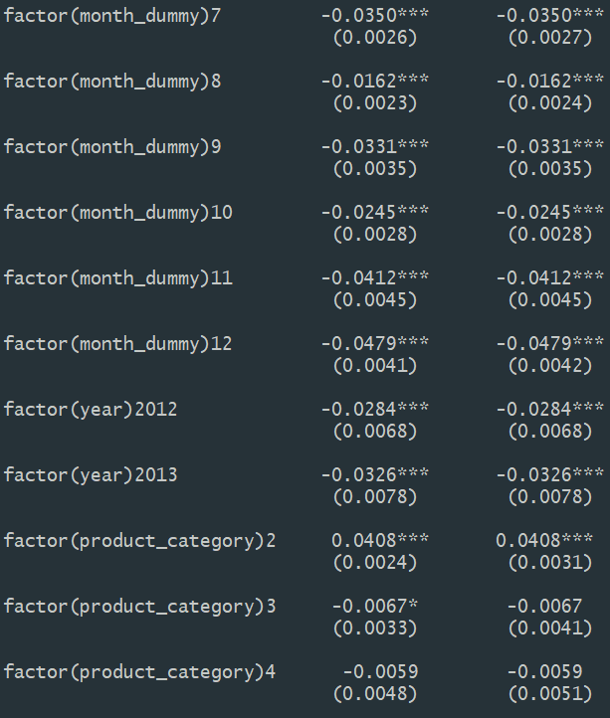
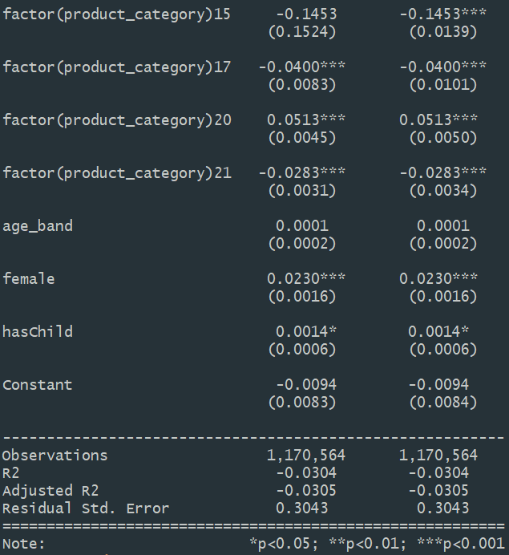
Question 4 - Full IV Reg Output

Slide 44
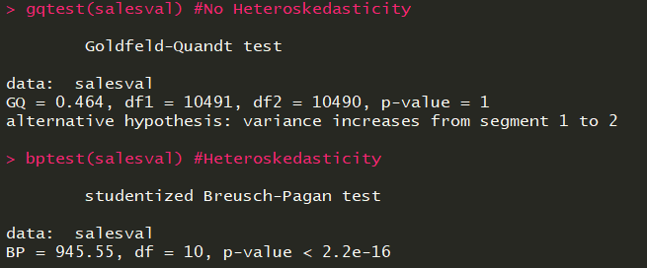



Question 5 - Heteroskedasticity
Sales Value
Return Value
Sales Quantity
Return Quantity

Slide 45


Question 5 - Choosing Negative Binomial
Sales Quantity
Return Quantity

Slide 46

Q6 - Sales Quantity
The marginal effect plots for all product categories
We found that 4 out of the 21 categories have a significant difference

Slide 47


Sales Quantity-
Product Category 1

Slide 48


Sales Quantity-
Product Category 4

Slide 49


Sales Quantity-
Product Category 14

Slide 50


Sales Quantity-
Product Category 21

